Slide 1
Contents
DNS – Domain Name System
The Web
Streaming Audio and Video
Content Delivery

Slide 2

The Application Layer
Starting the Application Layer!
– Builds distributed “network services” (DNS, Web) on Transport services
Application
Transport
Network
Link
Physical

Slide 3
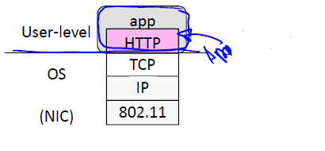
The Application Layer
Application layer protocols are often part of an “app”
– But don’t need a GUI, e.g., DNS

Slide 4
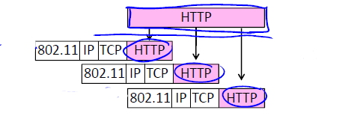
The Application Layer
Application layer messages are often split over multiple packets
– Or may be aggregated in a packet …

Slide 5
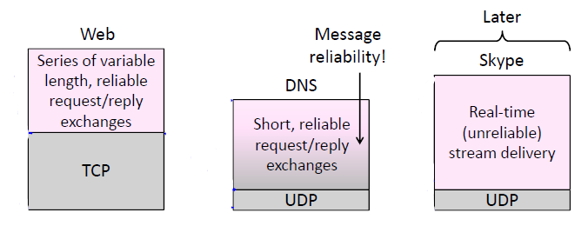
Application Communication Needs
Application Communication Needs
Vary widely with app; must build on Transport services

Slide 6
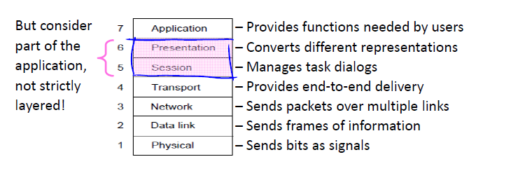
OSI Session/Presentation Layers
Remember this? Two relevant concepts …

Slide 7
Session Concept
A session is a series of related network interactions in support of an application task
– Often informal, not explicit
Examples:
– Web page fetches multiple resources
– Skype call involves audio, video, chat

Slide 8
Presentation Concept
Apps need to identify the type of content, and encode it for transfer
– These are Presentation functions
Examples:
– Media (MIME) types, e.g., image/jpeg, identify the type of content
– Transfer encodings, e.g., gzip, identify the encoding of the content
– Application headers are often simple and readable versus packed for efficiency

Slide 9
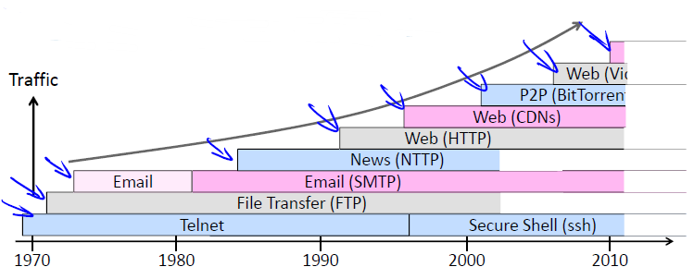
Evolution of Internet Applications
Always changing, and growing …

Slide 10
Evolution of Internet Applications
For a peek at the state of the Internet:
– Akamai’s State of the Internet Report (quarterly)
– Cisco’s Visual Networking Index
– Mary Meeker’s Internet Report
Robust Internet growth, esp. video, wireless and mobile
– Most traffic is video, will be 90% of Internet in a few years
– Wireless traffic will soon overtake wired traffic
– Mobile traffic is still a small portion (15%) of overall
– Growing attack traffic from China, also U.S. and Russia

Slide 11
Contents
DNS – Domain Name System
The Web
Streaming Audio and Video
Content Delivery

Slide 12
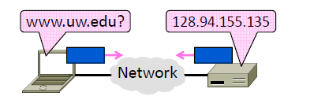
The Domain Name System
The DNS (Domain Name System)
– Human-readable host names, and more
– Part 1: the distributed namespace

Slide 13
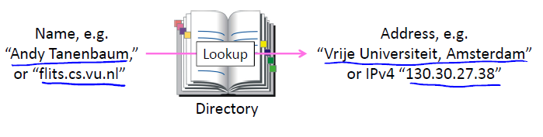
The Domain Name System
Names are higher-level identifiers for resources
Addresses are lower-level locators for resources
Resolution (or lookup) is mapping a name to an address

Slide 14
The Domain Name System
A naming service to map between host names and their IP addresses (and more)
– www.uwa.edu.au 130.95.128.140
Goals:
– Easy to manage (esp. with multiple parties)
– Efficient (good performance, few resources)
Approach:
– Distributed directory based on a hierarchical namespace
– Automated protocol to tie pieces together

Slide 15
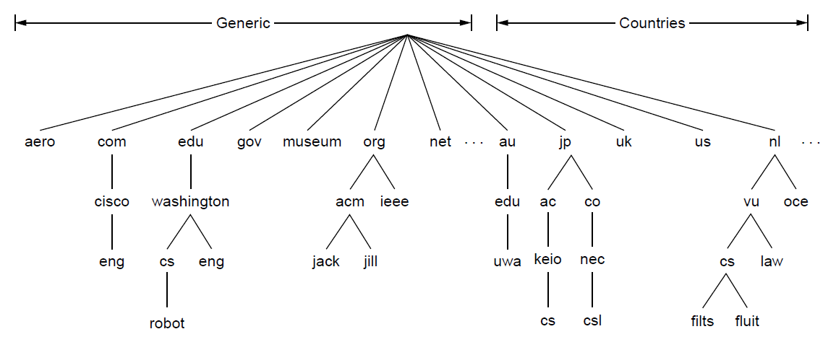
DNS Name Space
DNS namespace is hierarchical from the root down
Different parts delegated to different organizations
The computer robot.cs.washington.edu

Slide 16
TLDs (Top-Level Domains)
Run by ICANN (Internet Corp. for Assigned Names and Numbers)
Starting in ‘98; naming is financial, political, and international
22+ generic TLDs
Initially .com, .edu , .gov., .mil, .org, .net
Different TLDs have different usage policies
~250 country code TLDs
Two letters, e.g., “.au”, plus international characters since 2010
Many domain hacks, e.g., instagr.am (Armenia), goo.gl (Greenland)

Slide 17
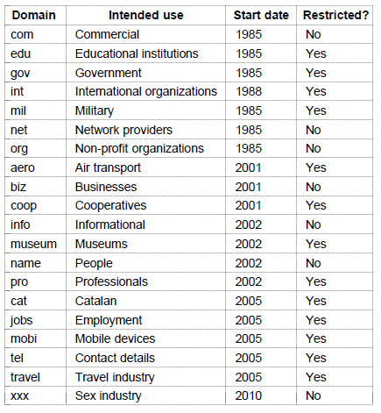


TLDs (Top-Level Domains)
Generic top-level domains are controlled by ICANN who appoints registrars to run them

Slide 18
TLDs (Top-Level Domains)
US to NGO Global
The contract regarding the IANA stewardship functions
between ICANN and the National Telecommunications and Information Administration (NTIA) of the United States Department of Commerce
Ended on October 1, 2016, formally transitioning the functions to the global multi-stakeholder community

Slide 19
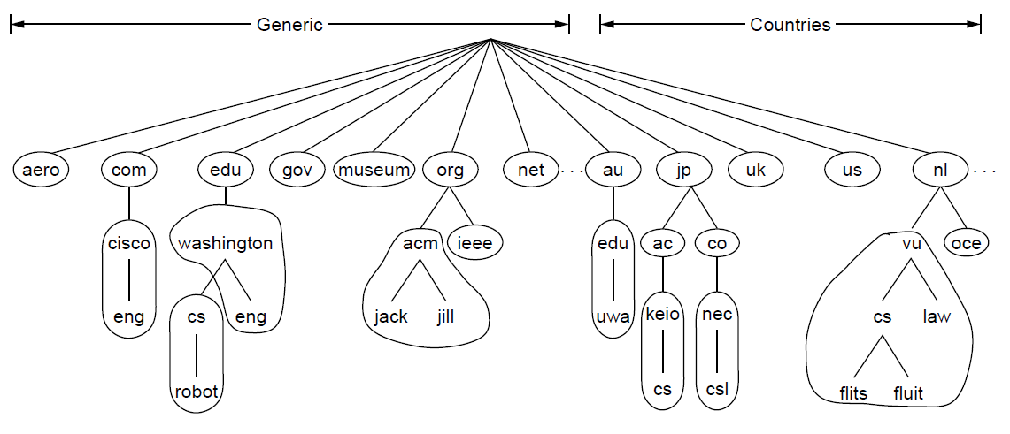
DNS Zone
A zone is a contiguous portion of the namespace
One zone

Slide 20
DNS Zone
Zones are the basis for distribution
– EDU Registrar administers .edu
– UW administers washington.edu
– CS&E administers cs.washington.edu
Each zone has a nameserver to contact for information about it
– Zone must include contacts for delegations, e.g., .edu knows nameserver for washington.edu

Slide 21
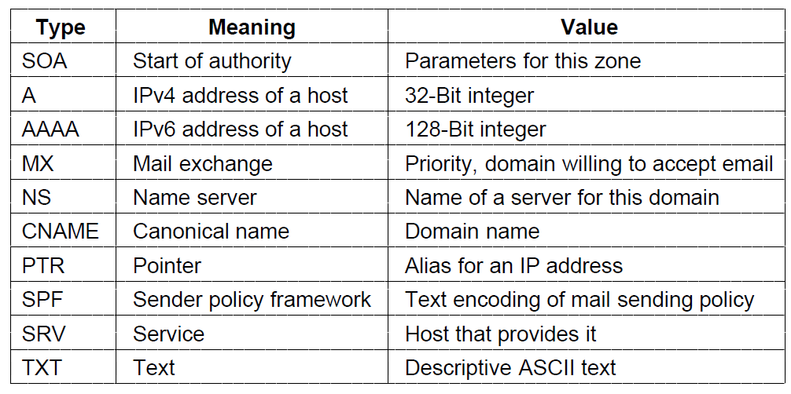
DNS Resource Records
A zone is comprised of DNS resource records that give information for its domain names

Slide 22
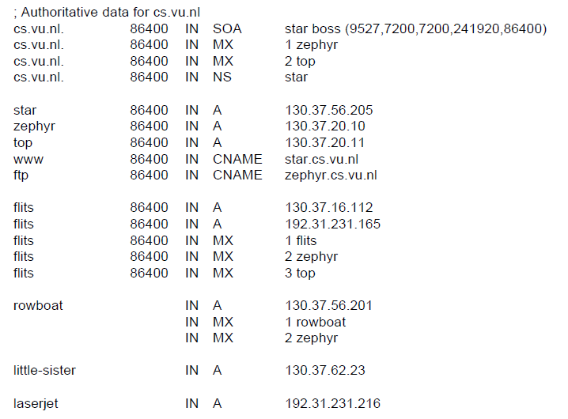
DNS Resource Records
Name server
IP addresses of computers
Mail gateways
A portion of a possible DNS database for cs.vu.nl.

Slide 23
DNS Resolution
Finding the IP address for a given hostname is called resolution and is done with the DNS protocol.
Resolution:
Computer requests local name server to resolve
Local name server asks the root name server
Root returns the name server for a lower zone
Continue down zones until name server can answer
DNS protocol:
Runs on UDP port 53, retransmits lost messages
Caches name server answers for better performance

Slide 24
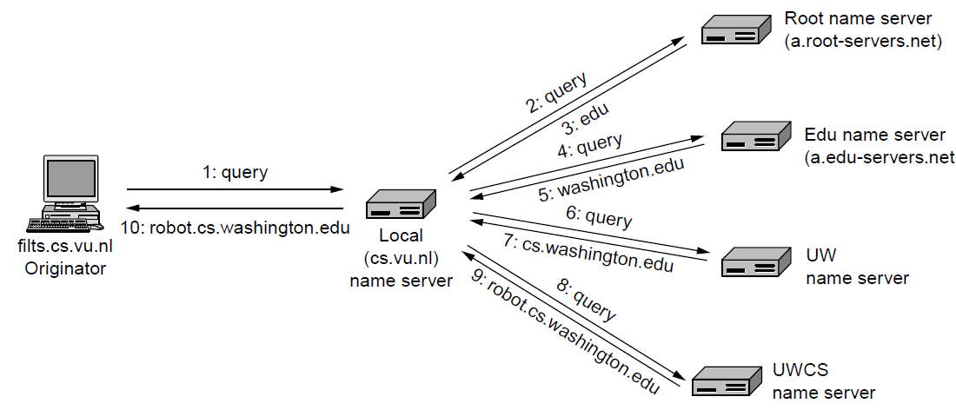
DNS Resolution

Slide 25
DNS Resolution
Recursive query
– Nameserver completes resolution and returns the final answer
– E.g., flits local nameserver
Iterative query
– Nameserver returns the answer or who to contact next for the answer
– E.g., local nameserverall others

Slide 26
DNS Resolution
Recursive query
– Lets server offload client burden (simple resolver) for manageability
– Lets server cache over a pool of clients for better performance
Iterative query
– Lets server “file and forget”
– Easy to build high load servers

Slide 27
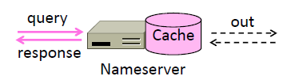
DNS Caching
Resolution latency should be low
– Adds delay to web browsing
Cache query/responses to answer future queries immediately
– Including partial (iterative) answers
– Responses carry a TTL for caching

Slide 28
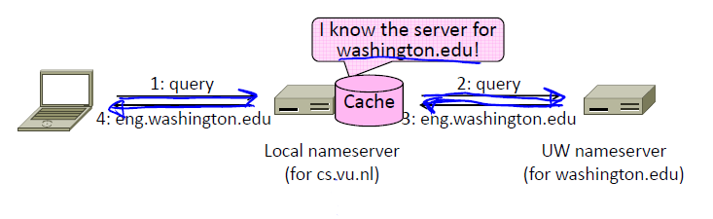
DNS Caching
flits.cs.vu.nl now resolves eng.washington.edu
– And previous resolutions cut out most of the process

Slide 29
DNS Servers
Local nameservers typically run by IT (enterprise, ISP)
– But may be your host or AP
– Or alternatives e.g., Google public DNS
Clients need to be able to contact their local nameservers
– Typically configured via DHCP
Root (dot) is served by 13 server names
– a.root-servers.net to m.root-servers.net
– All nameservers need root IP addresses
There are >250 distributed server instances
– Highly reachable, reliable service

Slide 30
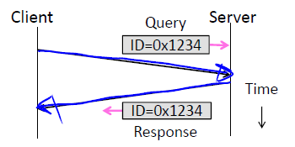
DNS Protocol
Query and response messages
– Built on UDP messages, port 53
– ARQ for reliability; server is stateless!
– Messages linked by a 16-bit ID field

Slide 31
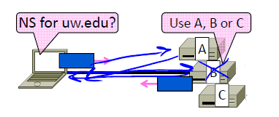
DNS Protocol
Service reliability via replicas
– Run multiple nameservers for domain
– Return the list; clients use one answer
– Helps distribute load too

Slide 32

DNS Protocol
Security is a major issue
– Compromise redirects to wrong site!
– Not part of initial protocols ..
DNSSEC (DNS Security Extensions)
– Long under development, now partially deployed. We’ll look at it later

Slide 33
Contents
DNS – Domain Name System
The Web
Content Delivery

Slide 34
The Application Layer
Continue the Application Layer!
– Builds distributed “network services” (DNS, Web) on Transport services
Application
Transport
Network
Link
Physical

Slide 35
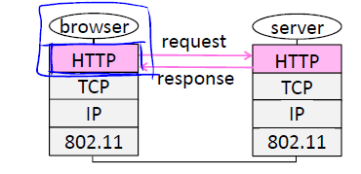
HTTP Protocol
HTTP is a request/response protocol for fetching Web resources
– Runs on TCP, typically port 80
– Part of browser/server app

Slide 36
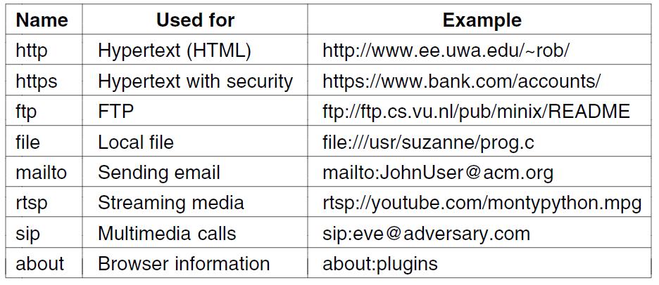
HTTP Protocol
Pages are named with URLs (Uniform Resource Locators)
Example: http://www.phdcomics.com/comics.php
Protocol
Server
Page on server
Our
focus
Common URL protocols

Slide 37
HTTP Protocol
Start with the page URL: http://en.wikipedia.org/wiki/Vegemite
Steps:
– Resolve the server to IP address (DNS)
– Set up TCP connection to the server
– Send HTTP request for the page
– (Await HTTP response for the page)
– Execute / fetch embedded resources / render
– Clean up any idle TCP connections

Slide 38
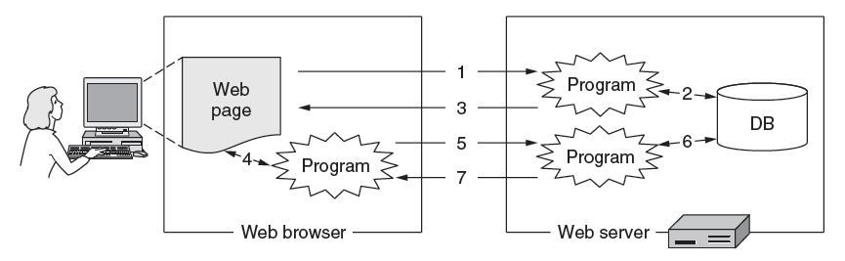
Static and Dynamic Pages
Static web page is a file contents, e.g., image
Dynamic web page is the result of program execution
– Javascript on client, PHP on server, or both

Slide 39
Static Pages
Static Web pages are simply files
Have the same contents for each viewing
Can be visually rich and interactive nonetheless:
HTML that mixes text and images
Forms that gather user input
Style sheets that tailor presentation
Vector graphics, videos, and more (over) . . .

Slide 40
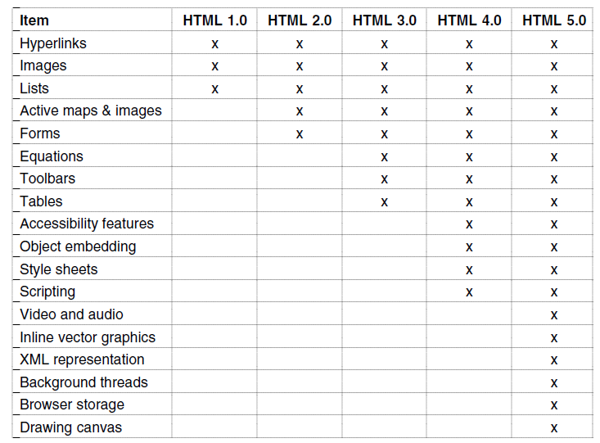
Static Pages

Slide 41
Dynamic Pages
Dynamic pages are generated by programs running at the server (with a database) and the client
E.g., PHP at server, JavaScript at client
Pages vary each time like using an application

Slide 42
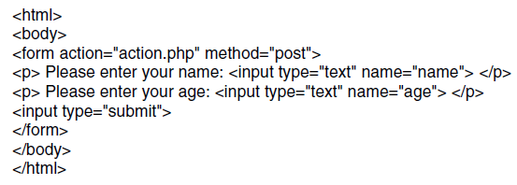
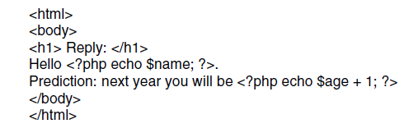
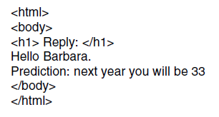
Dynamic Pages
Web page that gets form input and calls a server program
PHP calls
PHP server program that creates a custom Web page
Resulting Web page (for inputs “Barbara” and “32”)

Slide 43
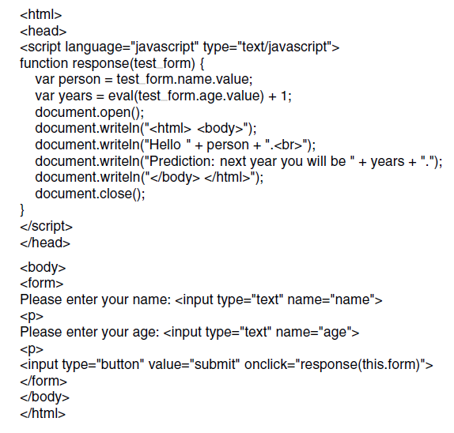
Dynamic Pages
JavaScript program produces result page in the browser
First page with form, gets input and calls program above

Slide 44
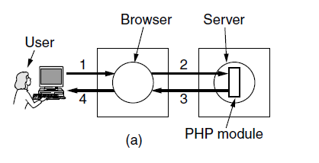
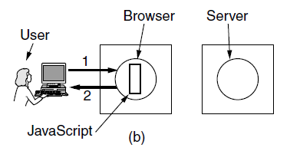
Dynamic Pages
The difference between server and client programs
Server-side scripting with PHP
Client-side scripting with JavaScript

Slide 45
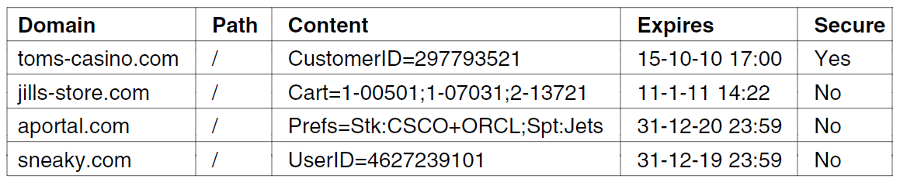
Cookies
Cookies support stateful client/server interactions
Server sends cookies (state) with page response
Client stores cookies across page fetches
Client sends cookies back to server with requests
Examples of cookies

Slide 46
HTTP Protocol
Originally a simple protocol, with many options added over time
– Text-based commands, headers
Try it yourself:
– As a “browser” fetching a URL
– Run “telnet en.wikipedia.org 80”
– Type “GET /wiki/Main_Page HTTP/1.1” to server followed by a blank line
– Server will return HTTP response with the page contents (or other info)

Slide 47
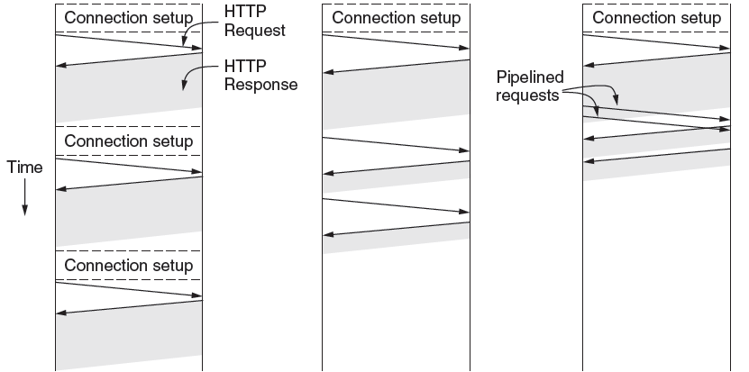
HTTP Protocol
HTTP uses persistent connections to improve performance
One connection for each request
Sequential requests on one connection
Pipelined requests on one connection

Slide 48
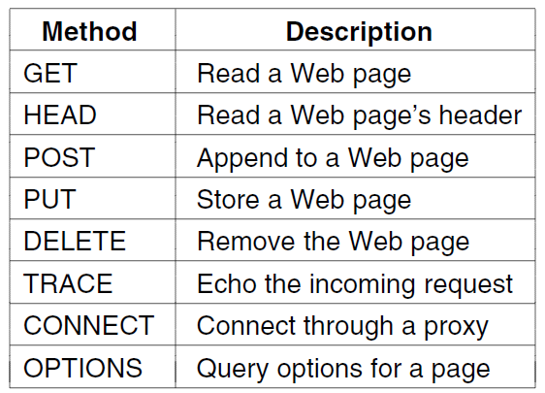
HTTP Protocol
Commands used in the request
Fetch a page
Used to send input data to a server program

Slide 49
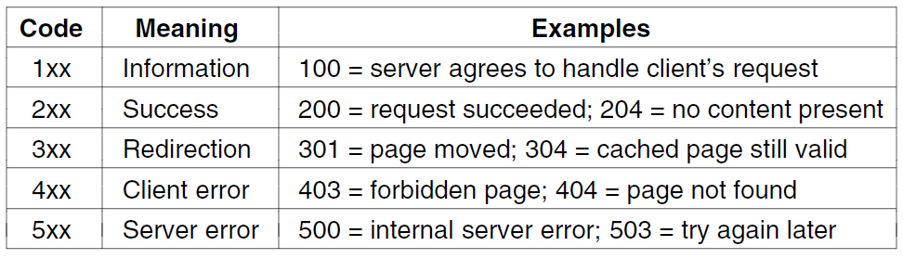
HTTP Protocol
Response codes tell the client how the request fared:

Slide 50
HTTP Protocol
Many header fields specify capabilities and content
– E.g., Content-Type: text/html, Cookie: lect=8-4-http
Function | Example Headers
Browser capabilities (client → server) | User-Agent, Accept, Accept-Charset, Accept-Encoding, Accept-Language
Caching related (mixed directions) | If-Modified-Since, If-None-Match, Date, Last-Modified, Expires, Cache-Control, ETag
Browser context (client → server) | Cookie, Referer, Authorization, Host
Content delivery (server → client) | Content-Encoding, Content-Length, Content-Type, Content-Language, Content-Range, Set-Cookie

Slide 51
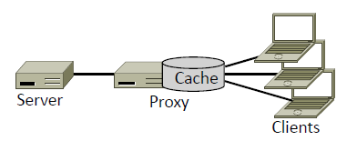
HTTP Cache
HTTP caching and proxies
– Enabling content reuse

Slide 52
HTTP Cache
Users often revisit web pages
– Big win from reusing local copy!
– This is caching
Key question:
– When is it OK to reuse local copy?
Locally determine copy is still valid
– Based on expiry information such as “Expires” header from server
– Or use a heuristic to guess (cacheable, freshly valid, not modified recently)
– Content is then available right away

Slide 53
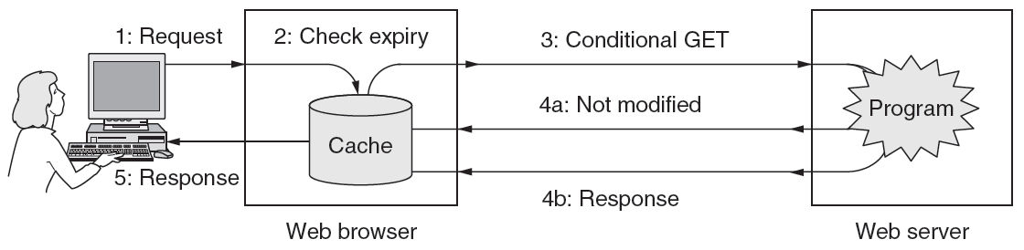
HTTP Cache
Revalidate copy with remote server
Based on timestamp of copy such as “Last-Modified” header from server
Or based on content of copy such as “Etag” header from server
Content is available after 1 RTT

Slide 54
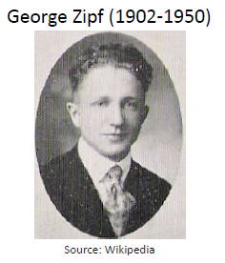
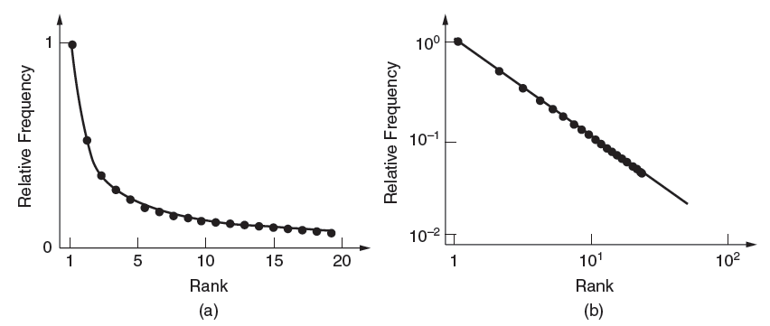
Content Delivery Networks
Internet traffic:
Shifts seismically (email→FTP→Web→P2P→video)
Has many small/unpopular and few large/popular flows – mice and elephants
Zipf popularity distribution, 1/k
Shows up as a line on log-log plot

Slide 55
Content Delivery Networks
How to place content near clients?
Use browser and proxy caches
– Helps, but limited to one client or clients in one organization
Want to place replicas across the Internet for use by all nearby clients
– Done by clever use of DNS

Slide 56
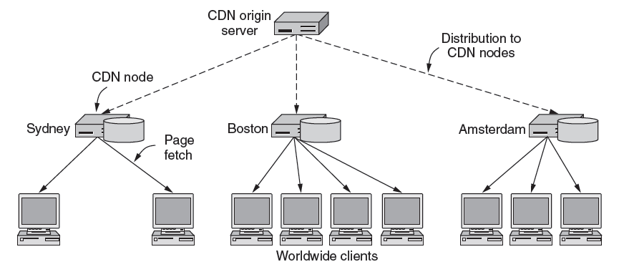
Content Delivery Networks
CDNs scale Web servers by having clients get content from a nearby CDN node (cache)

Slide 57
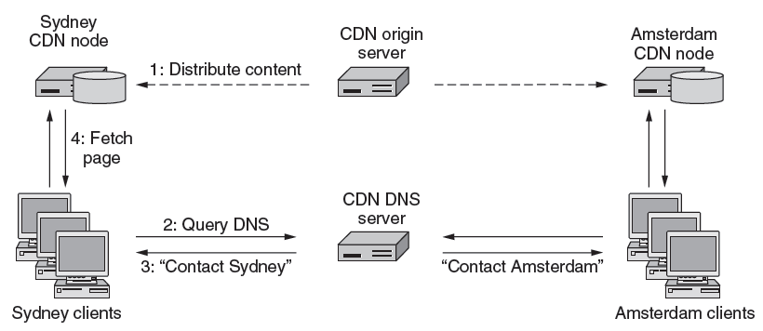
Content Delivery Networks
DNS resolution of site gives different answers to clients
– Tell each client the site is the nearest replica (map client IP)

Slide 58
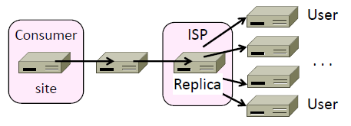
Content Delivery Networks
Clever model pioneered by Akamai
– Placing site replica at an ISP is win-win
– Improves site experience and reduces bandwidth usage of ISP

Slide 59
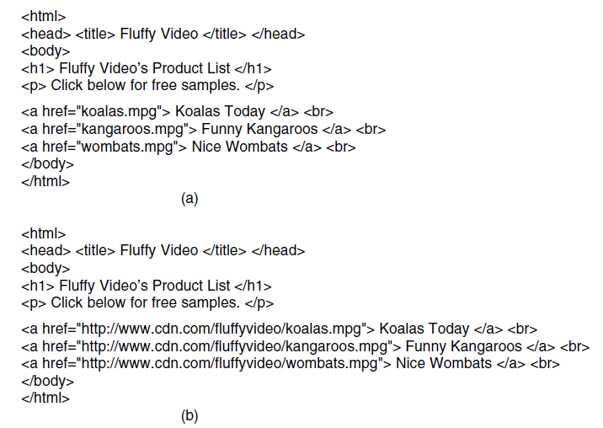
Content Delivery Networks
Traditional Web page on server
Page that distributes content via CDN

Slide 60
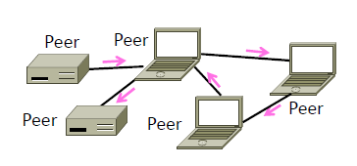
Peer to Peer Network
P2P (Peer-to-Peer) is an alternative CDN architecture with no dedicated infrastructure (i.e., servers)
Clients serve content to each other as peers

Slide 61
Peer to Peer Network
Challenges when servers are removed:
How do peers find each other?
How do peers support rapid content downloads?
How do peers encourage each other to upload?

Slide 62
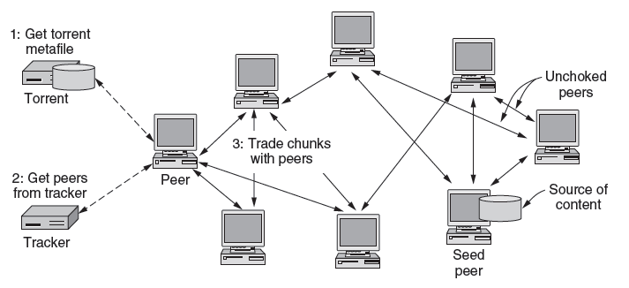
Peer to Peer Network
Peers find each other via Tracker in torrent file
Peers swap chunks (parts of content) with partners, preferring those who send most quickly
Many peers speed download; preference helps uploads

Slide 63
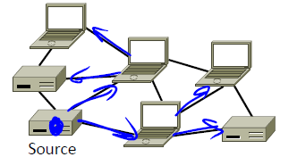
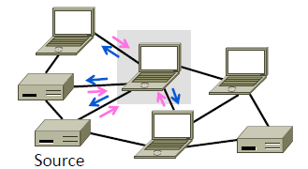
Peer to Peer Network
Peer can send content to all other peers using a distribution tree
Typically done with replicas over time
Self-scaling capacity
Peer play two roles:
Download to help themselves, and upload to help others

